Slide 1
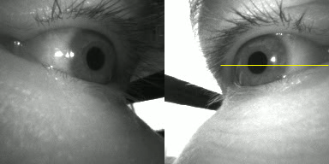
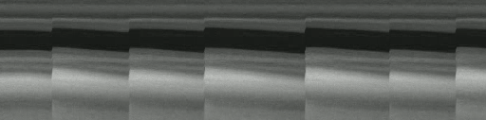
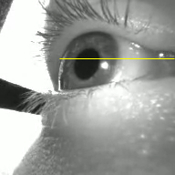
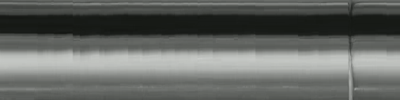
(a) Resolved OKN
(b) Low Resolution OKN
OKN
OKN-G
OKN-G
5 deg
2 sec
OKN-C
OKN-MMIC
Notes:
FIGURE 2. Results of automated OKN detection. (a) The Pupil Neon eye tracker and eye camera video. (b) An example of stereo-typical well-resolved OKN found from a single eye. The figure shows an image from the eye camera with a horizontal line indicating the source of pixels used to form the cross-sectional view. Below the cross-section is the gaze signal obtained from the Pupil Neon eyetracker slong-with automated OKN. (b) Low resolution OKN. In this case small amplitude/high frequency oscilations are seen in the eye camera video (see cross-sectional view and area within the dashed line). However, these oscillations are not readily apparent using OKN-G, although output from OKN-C and OKN-MMIC methods were successful.
NOTES FOR THIS IMAGE :
These oscillations were not well-resolved and in the gaze signal output. (c) An empty stimulus resulted in no OKN for the trial for the same participant. (d) results of centroid and motion microscope methods with stimulus present, and for comparison (e) stimulus absent. These results indicate sub-pixel oscillations of the eye.
RFIN
'./rfin_left_eye_v_2_0_DELL-S2716DG-11-06-2024_kids_long_screener_2/trials/trial-6-4_disk-condition-8-2/trial-6-4_disk-condition-8-2_cropped.mp4');
AHAR
ahar_left_eye_v_2_0_DELL-S2716DG-11-06-2024_kids_long_screener_2
trial-10-4_disk-condition-4-1_cropped.right
ahar_left_eye_v_2_0_DELL-S2716DG-11-06-2024_kids_long_screener_2
trial-12-4_no-disk-condition
Snapshot taken of:
anic_left_eye_v_2_0_DELL-S2716DG-11-06-2024_kids_long_screener
trial-4-2_disk-condition-10-1_cropped.mp4
# TRY THIS ONE INSTEAD
72.[656] true
date_id: 4Sept2024
participant_id: ahar
eye_id: left
trial_id: trial-10-4_disk-condition-4-1
subtrial: trial-10-4_disk-condition-4-1_cropped.right
decider: true
76.[668] true
date_id: 4Sept2024
participant_id: ahar
eye_id: right
trial_id: trial-10-4_disk-condition-4-1
subtrial: trial-10-4_disk-condition-4-1_cropped.right
decider: true

Slide 2
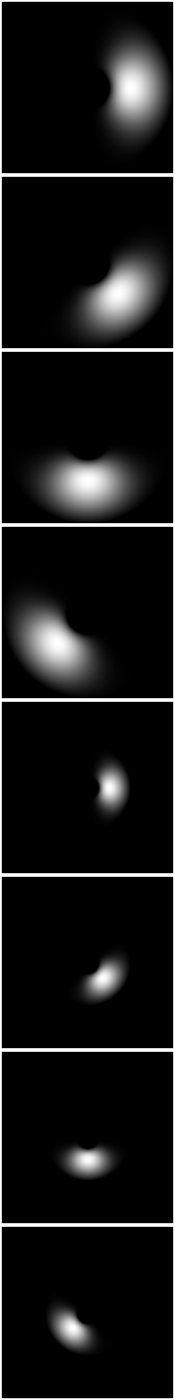
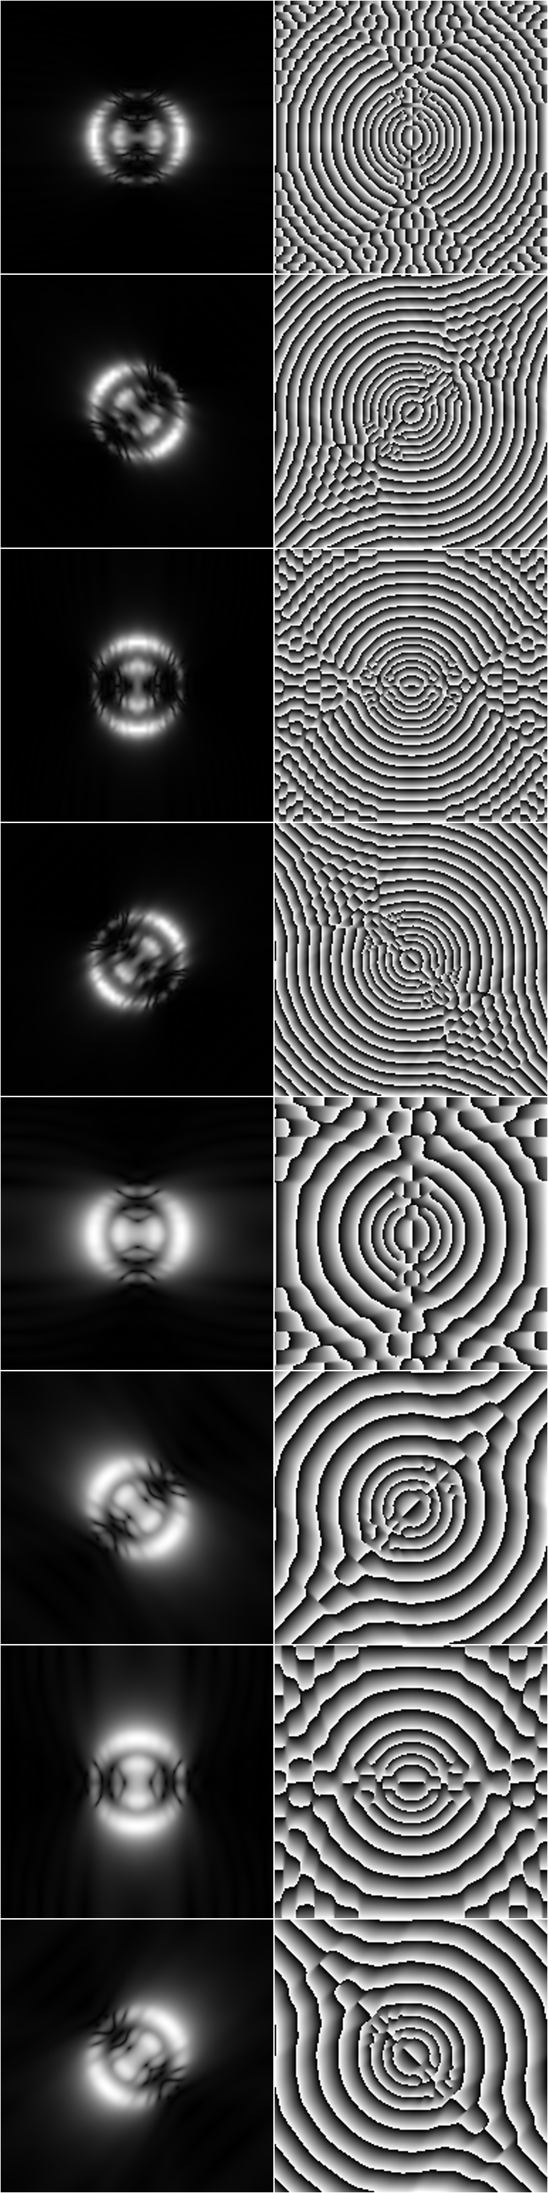


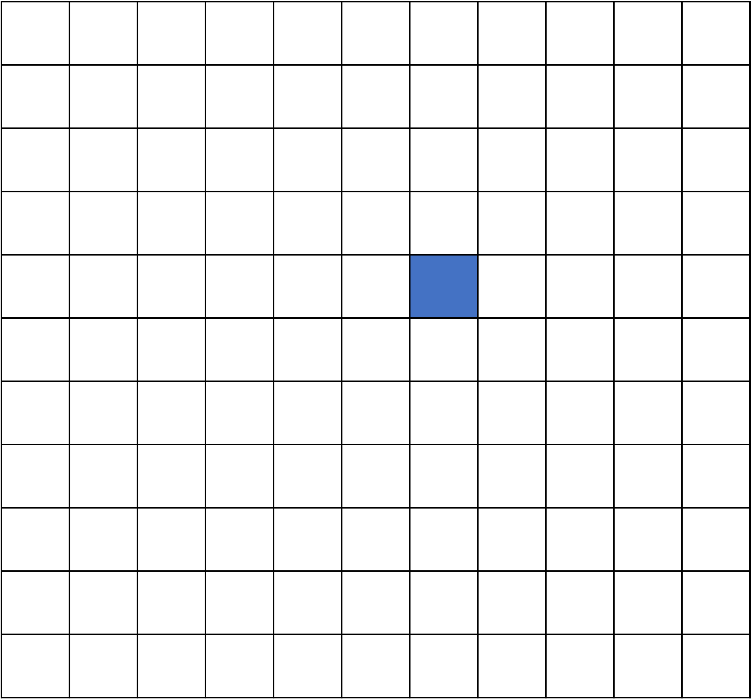
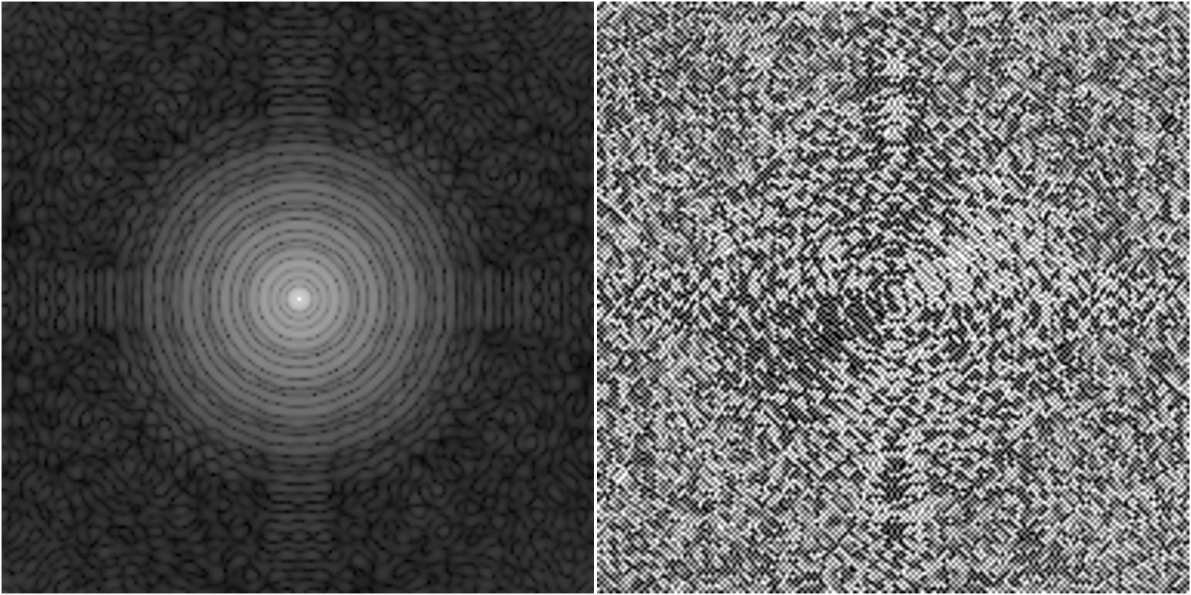
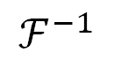
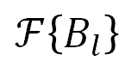


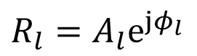


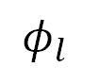

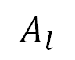

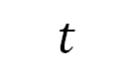
$ℱ\left\{B_{l}\right\}$
$$A_{l}$$
$φ_{l}$
LSQ
$$ℱ^{−1}$$
$$ℱ\left\{I\right\}$$
$$×$$
$$t$$
$$I\left(x,t\right)$$
$$\text{∠}ℱ\left\{I\right\}$$
$$\left|ℱ\left\{I\right\}\right|$$
$$Δx(t)$$
$R_{l}=A_{l}e^{jφ_{l}}$
Decompose
Estimate
Displacement
Estimate phase and amplirude
Notes:
FIGURE 3. The method takes the Fourier transform of the original image $I\left(x,t\right)$ and multiplies it by a bank of filters $ℱ\left\{B_{l}\right\}$ that each select for a particular frequency and orientation. The local phase $φ_{l}(x,t)$ and amplitude $A_{l}(x,t)$ is estimated by taking the inverse Fourier Transform of the result. Displacement estimation. An estimate of displacement is determined by a weighted least squares estimate of displacement obtained by a phase based optical flow equation
NOTES FOR THIS IMAGE :

Slide 3
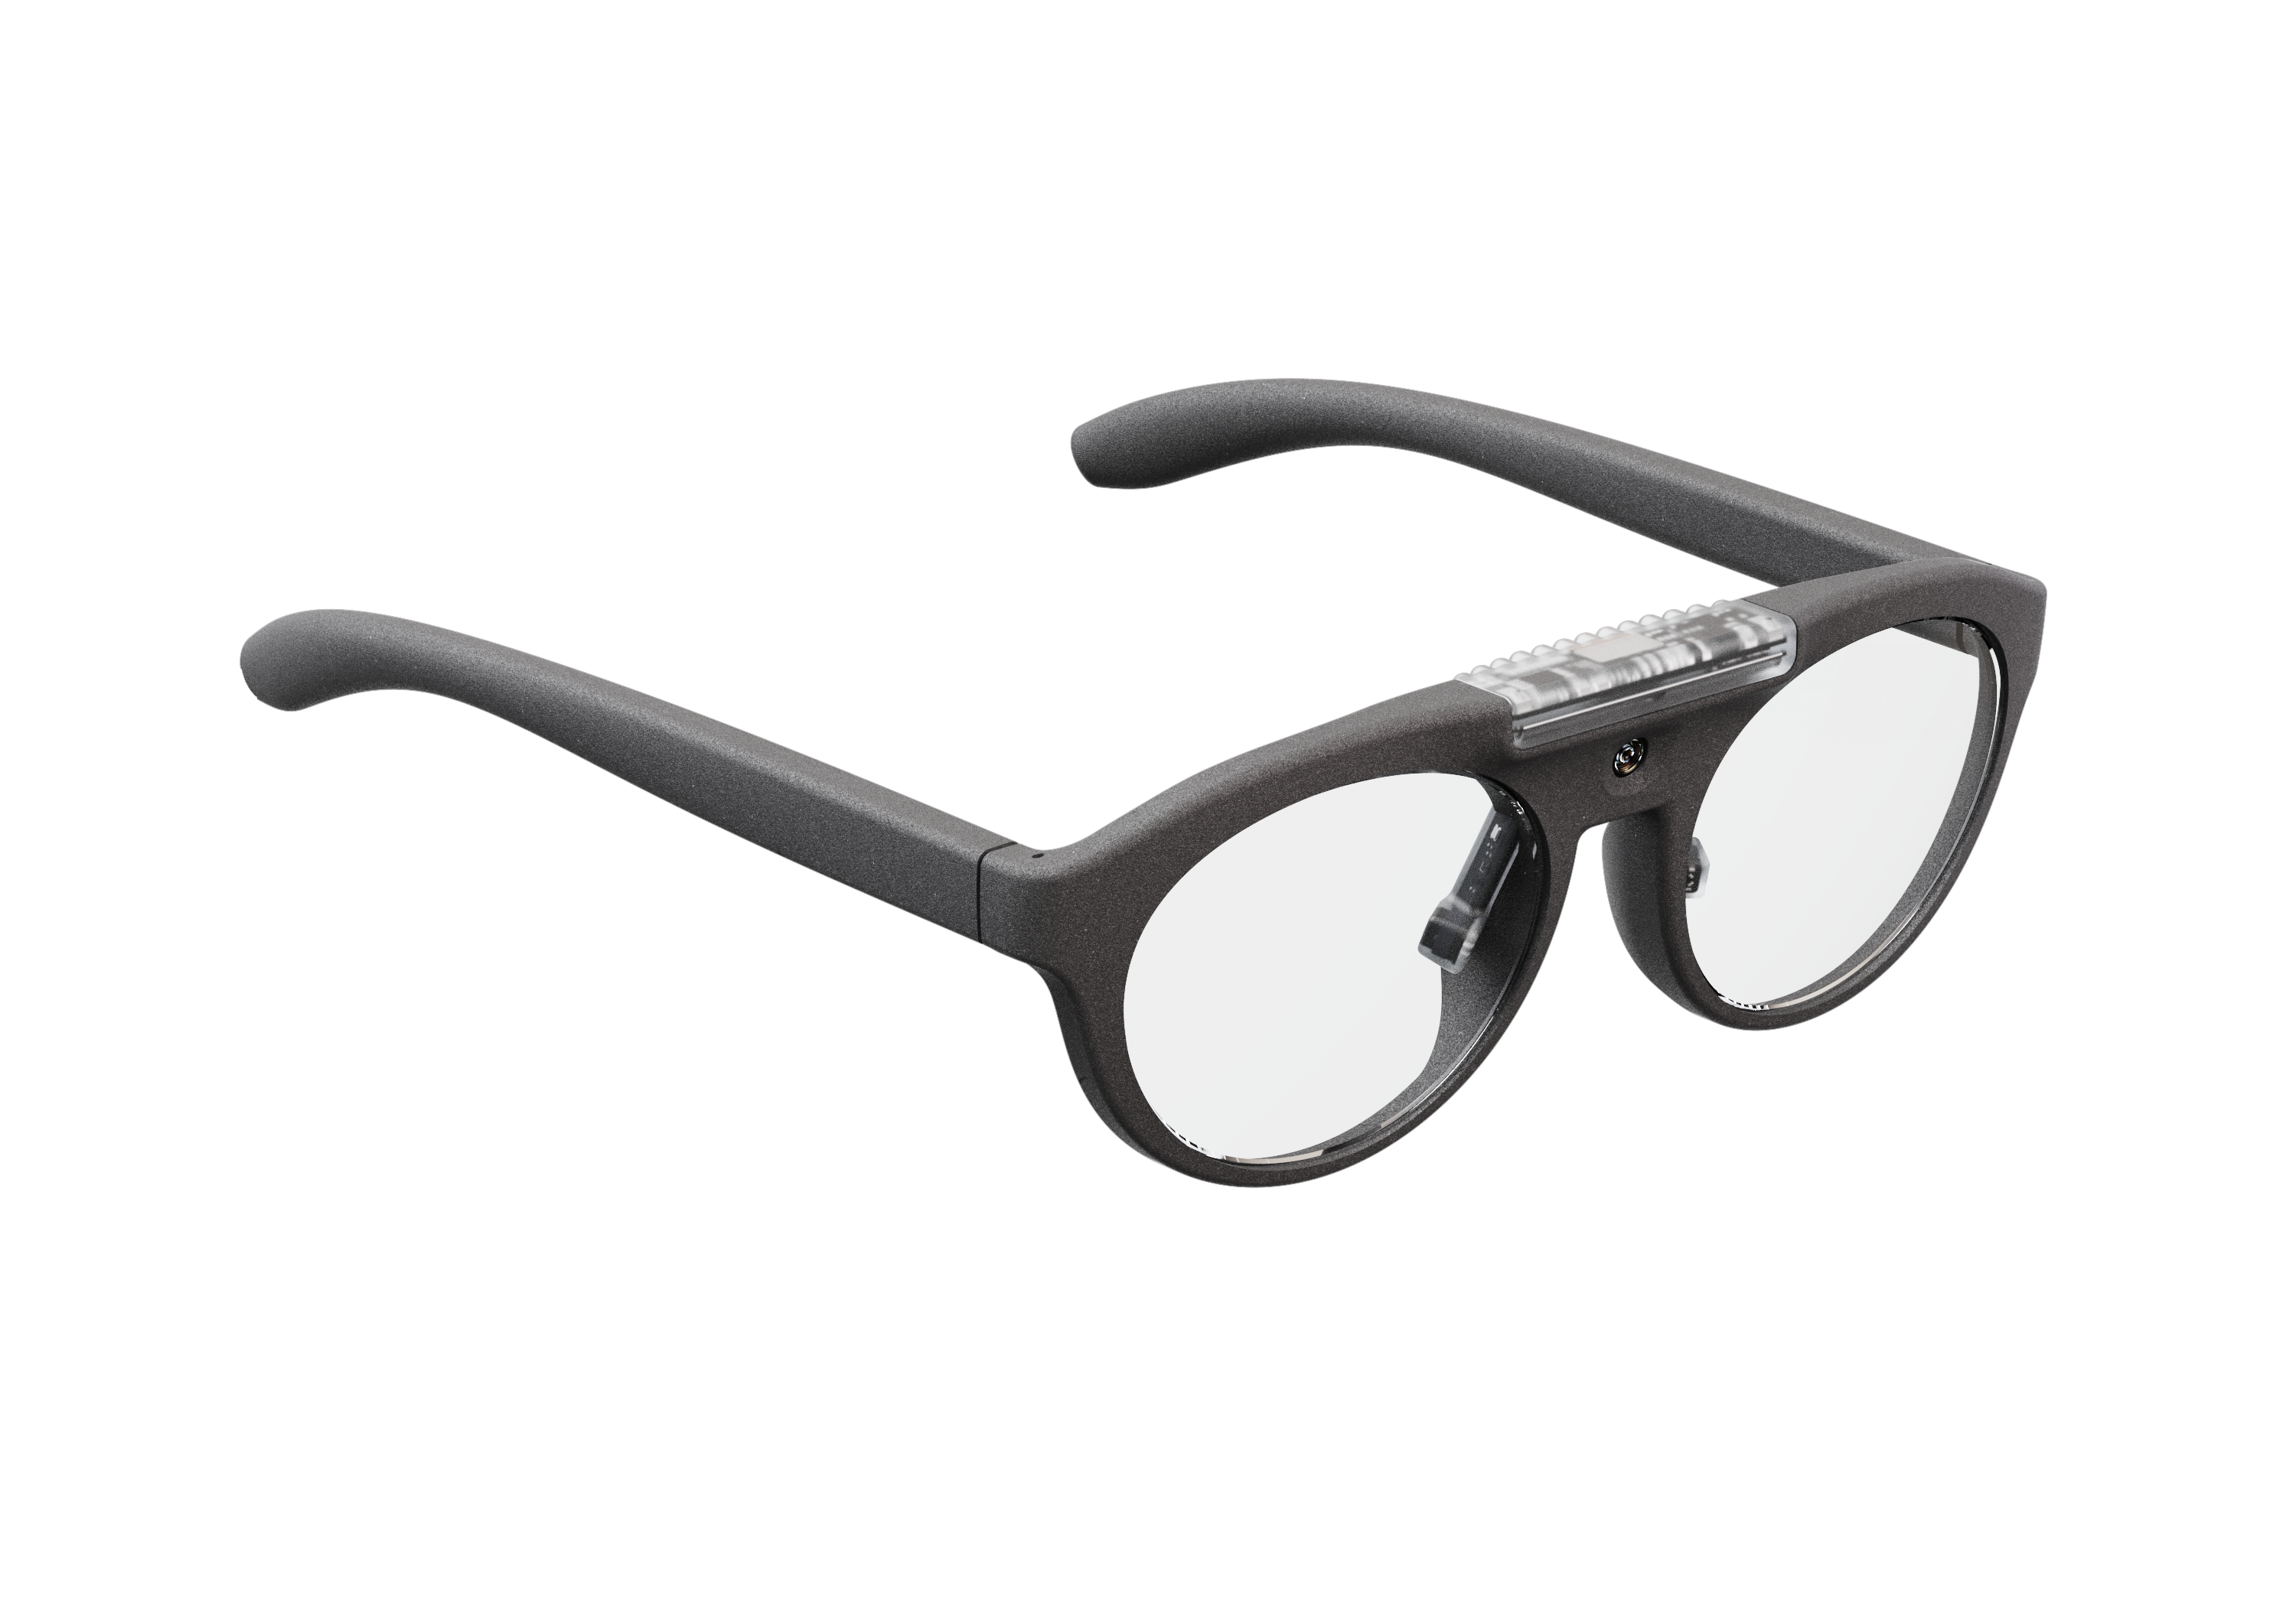
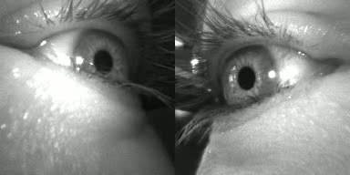
OKN Detection
Gaze (G)
OKN
p
OKN-G
Pupil Neon
Centroid Tracking
(C)
p'
OKN-C
Motion Microscope (MMIC)
p'
Right eye
OKN-MMIC
Left eye
S
T
F
OKN-C-STEP
Eye Selector
S
T
F
OKN-MMIC-STEP
Notes:
FIGURE 3. The methods compared. The gaze (G) obtained from the Pupil Neon eye tracking glasses is passed through the OKN detector to yield a per trial present/absent result (OKN-G). The OKN-C and OKN-MMIC methods are found after applying Centroid Tracking(C) or motion microscope (MMIC) methods applied to each eye. The STEP methods choose the result of the OKN-C/OKN-MMIC methods if OKN-G was false. For these methods, S is a switch used to select between methods.

Slide 4
Videos: 1056
Trials: 528
Corrupt
Video: 5
Trials: 3
Processing
Videos: 1051
Trials: 525
Low data-set
Videos: 218
Trials:167
>30% centroid
data loss
Main data-set
Videos: 833
Trials: 474
≤30% centroid
data loss
Retest data-set
Videos:107
Trials:73
Poor image quality
Notes:
FIGURE 4. Videos that were corrupted were removed from processing. The centroid algorithm was applied, and removed if they produced either no data or low data. The remaining eye camera videos were procedded in Experiment 1.
NOTES FOR THIS IMAGE :
2/2/25 changed from 136-129
>> patch_detections_by_manifest
Complete list = 1056
Exclusions applied to label database.
nb: removed commented lines = 4
Excluded applied. The input file should not contain excluded participants.
input manifest file = 967
Total trials = 1056
Corrupt videos = 5 [0.47]
No data trials = 89 [8.90]
Remaining trials = 962 [91.10]
- above detection (>=70) = 833 [86.59]
- below detection (<70) = 129 [13.41]
Total removed = 223 [21.12]
exclude file (129) = /Volumes/EXT_DATA/DATA/CONTROL/manifest.detections.exclude.txt
eligible file (833) = /Volumes/EXT_DATA/DATA/CONTROL/manifest.detections.eligible.txt
>> patch_diff_manifest
Complete length = 1056
Bad videos = 5
Remaining = 1051
Total detections eligible = 833.
problems = 218
low data = 136
no data = 82
>> patch_diff_manifest
Complete length = 1056
Bad videos = 5
Remaining = 1051
Total detections eligible = 826.
problems = 225
low data = 136
no data = 89
>>
OLD
1440
CENTROID
5 excluded videos (vwan)
1435
144 no detections (manifest.detections.diff.no_data.txt)
1291 detections (manifest.detections.txt) (1328 lines – 4 commented. 28 reported count excludes romb (16) + jimo (12) repeats)
low data: 161 (manifest.detections.exclude.txt) (165 lines – 4 extra due to romb)
good data: 1130 (manifest.detections.eligible.txt) (1154 lines - 24 extra due to romb (12) + jimo (12))
TP = 663
TN = 319
FP = 13
FN = 135
predicted: 305 errors
144 detection + 161 low data
However
161 low data
144 no data
305 data
WORKING OUT
NO : 112 no “updated_detection.csv” present
i.e., some sort of failure to generate data
YES : 1328 (manifest.detections.txt) (search criteria: “updated_detection.csv” present)
Includes 28 1st attempt videos [ jimo left (12), romb right (16) ]
EXCLUDE : 5 bad videos
INCLUDE :
1323
NO : 165 (manifest.detections.excluded) (low data 30% data)
including jimo (4) 1st attempt
161 LEFT
YES : 1158 (manifest.detections.eligible) (>= 70% data)
Inlcudes 12 (jimo) & 12 (romb)
EXCLUDE: 12 JIMO + 12 ROMB
YES: 1134 remainder
TP = 667
TN = 319
FP = 13
FN = 135
TOTAL = 1134

Slide 5
(b)
 |  | OKN-C
 |  | Present | Absent | Total
Human | Present | TP 284 59% | FN 36 8% | 320 68%
 | Absent | FP 6 1% | TN 148 31% | 154 30%
Total |  | 290 61% | 184 39% | 474
(c)
 |  | OKN-MMIC
 |  | Present | Absent | Total
Human | Present | TP 284 60% | FN 36 8% | 320 68%
 | Absent | FP 8 2% | TN 146 31% | 154 32%
Total |  | 292 62% | 182 38% | 474
 |  | OKN-G
 |  | Present | Absent | Total
Human | Present | TP 271 57% | FN 49 10% | 320 68%
 | Absent | FP 7 1% | TN 147 31% | 196 41%
Total |  | 278 59% | 196 41% | 474
(d)
 |  | OKN-C-STEP
 |  | Present | Absent | Total
Human | Present | TP 297 63% | FN 23 5% | 320 68%
 | Absent | FP 13 3% | TN 141 30% | 154 32%
Total |  | 310 65% | 164 35% | 474
(e)
 |  | OKN-MMIC-STEP
 |  | Present | Absent | Total
Human | Present | TP 304 64% | FN 16 3% | 320 68%
 | Absent | FP 15 3% | TN 139 29% | 154 32%
Total |  | 319 67% | 155 33% | 474
(a)
Notes:
FIGURE 5. Confusion matrices for automated OKN using : (a) baseline gaze signal (OKN-G), (b) pupil centroid tracking (OKN-C), (c) phase based estimation (OKN-MMIC), (d) centroid tracking applied to negative OKN-G tests only (OKN-C-STEP) and (e) motion microscope applied to negative OKN-G tests only (OKN-MMIC-STEP).
NOTES FOR THIS IMAGE :
experiment_summarize_centroid_tracking_by_manifest
ans =
7
OKN-GAZE.
TP = 271 (57.17)
FP = 7 (1.48)
TN = 147 (31.01)
FN = 49 (10.34)
sum in P = 320 (67.51)
sum in N = 154 (32.49)
sum out P = 278 (58.65)
sum out N = 196 (41.35)
sum total = 474
Sensitivity = 0.85
Specificity = 0.95
Accuracy = 0.88
PPV = 0.97
NPV = 0.75
F1 = 0.91
OKN-NEW (CENTROID)
TP = 284 (59.92)
FP = 6 (1.27)
TN = 148 (31.22)
FN = 36 (7.59)
sum in P = 320 (67.51)
sum in N = 154 (32.49)
sum out P = 290 (61.18)
sum out N = 184 (38.82)
sum total = 474
Sensitivity = 0.89
Specificity = 0.96
Accuracy = 0.91
PPV = 0.98
NPV = 0.80
F1 = 0.93
OKN-NEWER (CENTROID)
TP = 297 (62.66)
FP = 13 (2.74)
TN = 141 (29.75)
FN = 23 (4.85)
sum in P = 320 (67.51)
sum in N = 154 (32.49)
sum out P = 310 (65.40)
sum out N = 164 (34.60)
sum total = 474
Sensitivity = 0.93
Specificity = 0.92
Accuracy = 0.92
PPV = 0.96
NPV = 0.86
F1 = 0.94

Slide 6
 |  | OKN-G
 |  | Present | Absent | Total
Human | Present | TP 271 57% | FN 49 10% | 320 68%
 | Absent | FP 7 1% | TN 147 31% | 196 41%
 | Total | 278 59% | 196 41% | 474
(a)

Slide 7
 |  | OKN-C
 |  | Present | Absent | Total
Human | Present | TP 284 59% | FN 36 8% | 320 68%
 | Absent | FP 6 1% | TN 148 31% | 154 30%
 | Total | 290 61% | 184 39% | 474
(b)

Slide 8
 |  | OKN-MMIC
 |  | Present | Absent | Total
Human | Present | TP 284 60% | FN 36 8% | 320 68%
 | Absent | FP 8 2% | TN 146 31% | 154 32%
 | Total | 292 62% | 182 38% | 474
(c)

Slide 9
 |  | OKN-C-STEP
 |  | Present | Absent | Total
Human | Present | TP 297 63% | FN 23 5% | 320 68%
 | Absent | FP 13 3% | TN 141 30% | 154 32%
 | Total | 310 65% | 164 35% | 474
(d)

Slide 10
 |  | OKN-MMIC-STEP
 |  | Present | Absent | Total
Human | Present | TP 304 64% | FN 16 3% | 320 68%
 | Absent | FP 15 3% | TN 139 29% | 154 32%
 | Total | 319 67% | 155 33% | 474
(d)

Slide 11
 |  | OKN-G
 |  | Present | Absent | Total
Human | Present | TP 50 47% | FN 19 18% | 69 64%
 | Absent | FP 1 1% | TN 37 36% | 38 36%
 | Total | 51 48% | 56 52% | 107
 |  | OKN-MMIC
 |  | Present | Absent | Total
Human | Present | TP 61 57% | FN 8 7% | 69 64%
 | Absent | FP 0 0% | TN 38 36% | 38 36%
 | Total | 61 48% | 46 43% | 107
 |  | OKN-MMIC-STEP
 |  | Present | Absent | Total
Human | Present | TP 63 59% | FN 6 6% | 69 64%
 | Absent | FP 1 1% | TN 37 35% | 38 36%
 | Total | 64 60% | 43 40% | 107
(a)
(b)
(c)
Notes:
FIGURE 6. Performance metrics for the baseline method OKN-MMIC applied to low data and no data results from selected participant video. Confusion matrices for automated OKN using : (a) baseline gaze signal (OKN-G), (b) phase based estimation (OKN-MMIC) and (c) motion microscope applied to negative OKN-G tests only (OKN-MMIC-STEP).
NOTES
>> patch_diff_manifest
Complete length = 1056
Bad videos = 5
Remaining = 1051
Total detections eligible = 833.
problems = 218
low data = 136
no data = 82
>> patch_TP_manifest
input = /Volumes/EXT_DATA/DATA/CONTROL/manifest.updated_motion.problems.txt (lines = 107)
output = /Volumes/EXT_DATA/DATA/CONTROL/manifest.updated_motion.problems.TP.txt (lines = 50)
output manifest # = 50
>> patch_TN_manifest
input = /Volumes/EXT_DATA/DATA/CONTROL/manifest.updated_motion.problems.txt (lines = 107)
output = /Volumes/EXT_DATA/DATA/CONTROL/manifest.updated_motion.problems.TN.txt (lines = 37)
output manifest # = 37
>> patch_FP_manifest
input = /Volumes/EXT_DATA/DATA/CONTROL/manifest.updated_motion.problems.txt (lines = 107)
output = /Volumes/EXT_DATA/DATA/CONTROL/manifest.updated_motion.problems.FP.txt (lines = 1)
output manifest # = 1
>> patch_FN_manifest
input = /Volumes/EXT_DATA/DATA/CONTROL/manifest.updated_motion.problems.txt (lines = 107)
output = /Volumes/EXT_DATA/DATA/CONTROL/manifest.updated_motion.problems.FN.txt (lines = 19)
output manifest # = 19
>>
OKN-GAZE.
TP = 50 (46.73)
FP = 1 (0.93)
TN = 37 (34.58)
FN = 19 (17.76)
sum in P = 69 (64.49)
sum in N = 38 (35.51)
sum out P = 51 (47.66)
sum out N = 56 (52.34)
sum total = 107
Sensitivity = 0.72
Specificity = 0.97
Accuracy = 0.81
PPV = 0.98
NPV = 0.66
F1 = 0.83
OKN-NEW (MOTION_PROBLEMS)
TP = 61 (57.01)
FP = 0 (0.00)
TN = 38 (35.51)
FN = 8 (7.48)
sum in P = 69 (64.49)
sum in N = 38 (35.51)
sum out P = 61 (57.01)
sum out N = 46 (42.99)
sum total = 107
Sensitivity = 0.88
Specificity = 1.00
Accuracy = 0.93
PPV = 1.00
NPV = 0.83
F1 = 0.94
OKN-NEWER (MOTION_PROBLEMS)
TP = 63 (58.88)
FP = 1 (0.93)
TN = 37 (34.58)
FN = 6 (5.61)
sum in P = 69 (64.49)
sum in N = 38 (35.51)
sum out P = 64 (59.81)
sum out N = 43 (40.19)
sum total = 107
Sensitivity = 0.91
Specificity = 0.97
Accuracy = 0.93
PPV = 0.98
NPV = 0.86
F1 = 0.95

Slide 12
 |  | OKN-G
 |  | Present | Absent | Total
Human | Present | TP 50 47% | FN 19 18% | 69 64%
 | Absent | FP 1 1% | TN 37 36% | 38 36%
 | Total | 51 48% | 56 52% | 107
(a)
Notes:
FIGURE 6. Performance metrics for the baseline method OKN-MMIC applied to low data and no data results from selected participant video. Confusion matrices for automated OKN using : (a) baseline gaze signal (OKN-G), (b) phase based estimation (OKN-MMIC) and (c) motion microscope applied to negative OKN-G tests only (OKN-MMIC-STEP).
NOTES
>> patch_diff_manifest
Complete length = 1056
Bad videos = 5
Remaining = 1051
Total detections eligible = 833.
problems = 218
low data = 136
no data = 82
>> patch_TP_manifest
input = /Volumes/EXT_DATA/DATA/CONTROL/manifest.updated_motion.problems.txt (lines = 107)
output = /Volumes/EXT_DATA/DATA/CONTROL/manifest.updated_motion.problems.TP.txt (lines = 50)
output manifest # = 50
>> patch_TN_manifest
input = /Volumes/EXT_DATA/DATA/CONTROL/manifest.updated_motion.problems.txt (lines = 107)
output = /Volumes/EXT_DATA/DATA/CONTROL/manifest.updated_motion.problems.TN.txt (lines = 37)
output manifest # = 37
>> patch_FP_manifest
input = /Volumes/EXT_DATA/DATA/CONTROL/manifest.updated_motion.problems.txt (lines = 107)
output = /Volumes/EXT_DATA/DATA/CONTROL/manifest.updated_motion.problems.FP.txt (lines = 1)
output manifest # = 1
>> patch_FN_manifest
input = /Volumes/EXT_DATA/DATA/CONTROL/manifest.updated_motion.problems.txt (lines = 107)
output = /Volumes/EXT_DATA/DATA/CONTROL/manifest.updated_motion.problems.FN.txt (lines = 19)
output manifest # = 19
>>
OKN-GAZE.
TP = 50 (46.73)
FP = 1 (0.93)
TN = 37 (34.58)
FN = 19 (17.76)
sum in P = 69 (64.49)
sum in N = 38 (35.51)
sum out P = 51 (47.66)
sum out N = 56 (52.34)
sum total = 107
Sensitivity = 0.72
Specificity = 0.97
Accuracy = 0.81
PPV = 0.98
NPV = 0.66
F1 = 0.83
OKN-NEW (MOTION_PROBLEMS)
TP = 61 (57.01)
FP = 0 (0.00)
TN = 38 (35.51)
FN = 8 (7.48)
sum in P = 69 (64.49)
sum in N = 38 (35.51)
sum out P = 61 (57.01)
sum out N = 46 (42.99)
sum total = 107
Sensitivity = 0.88
Specificity = 1.00
Accuracy = 0.93
PPV = 1.00
NPV = 0.83
F1 = 0.94
OKN-NEWER (MOTION_PROBLEMS)
TP = 63 (58.88)
FP = 1 (0.93)
TN = 37 (34.58)
FN = 6 (5.61)
sum in P = 69 (64.49)
sum in N = 38 (35.51)
sum out P = 64 (59.81)
sum out N = 43 (40.19)
sum total = 107
Sensitivity = 0.91
Specificity = 0.97
Accuracy = 0.93
PPV = 0.98
NPV = 0.86
F1 = 0.95

Slide 13
 |  | OKN-MMIC
 |  | Present | Absent | Total
Human | Present | TP 61 57% | FN 8 7% | 69 64%
 | Absent | FP 0 0% | TN 38 36% | 38 36%
 | Total | 61 48% | 46 43% | 107
(b)
Notes:
FIGURE 6. Performance metrics for the baseline method OKN-MMIC applied to low data and no data results from selected participant video. Confusion matrices for automated OKN using : (a) baseline gaze signal (OKN-G), (b) phase based estimation (OKN-MMIC) and (c) motion microscope applied to negative OKN-G tests only (OKN-MMIC-STEP).
NOTES
>> patch_diff_manifest
Complete length = 1056
Bad videos = 5
Remaining = 1051
Total detections eligible = 833.
problems = 218
low data = 136
no data = 82
>> patch_TP_manifest
input = /Volumes/EXT_DATA/DATA/CONTROL/manifest.updated_motion.problems.txt (lines = 107)
output = /Volumes/EXT_DATA/DATA/CONTROL/manifest.updated_motion.problems.TP.txt (lines = 50)
output manifest # = 50
>> patch_TN_manifest
input = /Volumes/EXT_DATA/DATA/CONTROL/manifest.updated_motion.problems.txt (lines = 107)
output = /Volumes/EXT_DATA/DATA/CONTROL/manifest.updated_motion.problems.TN.txt (lines = 37)
output manifest # = 37
>> patch_FP_manifest
input = /Volumes/EXT_DATA/DATA/CONTROL/manifest.updated_motion.problems.txt (lines = 107)
output = /Volumes/EXT_DATA/DATA/CONTROL/manifest.updated_motion.problems.FP.txt (lines = 1)
output manifest # = 1
>> patch_FN_manifest
input = /Volumes/EXT_DATA/DATA/CONTROL/manifest.updated_motion.problems.txt (lines = 107)
output = /Volumes/EXT_DATA/DATA/CONTROL/manifest.updated_motion.problems.FN.txt (lines = 19)
output manifest # = 19
>>
OKN-GAZE.
TP = 50 (46.73)
FP = 1 (0.93)
TN = 37 (34.58)
FN = 19 (17.76)
sum in P = 69 (64.49)
sum in N = 38 (35.51)
sum out P = 51 (47.66)
sum out N = 56 (52.34)
sum total = 107
Sensitivity = 0.72
Specificity = 0.97
Accuracy = 0.81
PPV = 0.98
NPV = 0.66
F1 = 0.83
OKN-NEW (MOTION_PROBLEMS)
TP = 61 (57.01)
FP = 0 (0.00)
TN = 38 (35.51)
FN = 8 (7.48)
sum in P = 69 (64.49)
sum in N = 38 (35.51)
sum out P = 61 (57.01)
sum out N = 46 (42.99)
sum total = 107
Sensitivity = 0.88
Specificity = 1.00
Accuracy = 0.93
PPV = 1.00
NPV = 0.83
F1 = 0.94
OKN-NEWER (MOTION_PROBLEMS)
TP = 63 (58.88)
FP = 1 (0.93)
TN = 37 (34.58)
FN = 6 (5.61)
sum in P = 69 (64.49)
sum in N = 38 (35.51)
sum out P = 64 (59.81)
sum out N = 43 (40.19)
sum total = 107
Sensitivity = 0.91
Specificity = 0.97
Accuracy = 0.93
PPV = 0.98
NPV = 0.86
F1 = 0.95

Slide 14
 |  | OKN-MMIC-STEP
 |  | Present | Absent | Total
Human | Present | TP 63 59% | FN 6 6% | 69 64%
 | Absent | FP 1 1% | TN 37 35% | 38 36%
 | Total | 64 60% | 43 40% | 107
(c)
Notes:
FIGURE 6. Performance metrics for the baseline method OKN-MMIC applied to low data and no data results from selected participant video. Confusion matrices for automated OKN using : (a) baseline gaze signal (OKN-G), (b) phase based estimation (OKN-MMIC) and (c) motion microscope applied to negative OKN-G tests only (OKN-MMIC-STEP).
NOTES
>> patch_diff_manifest
Complete length = 1056
Bad videos = 5
Remaining = 1051
Total detections eligible = 833.
problems = 218
low data = 136
no data = 82
>> patch_TP_manifest
input = /Volumes/EXT_DATA/DATA/CONTROL/manifest.updated_motion.problems.txt (lines = 107)
output = /Volumes/EXT_DATA/DATA/CONTROL/manifest.updated_motion.problems.TP.txt (lines = 50)
output manifest # = 50
>> patch_TN_manifest
input = /Volumes/EXT_DATA/DATA/CONTROL/manifest.updated_motion.problems.txt (lines = 107)
output = /Volumes/EXT_DATA/DATA/CONTROL/manifest.updated_motion.problems.TN.txt (lines = 37)
output manifest # = 37
>> patch_FP_manifest
input = /Volumes/EXT_DATA/DATA/CONTROL/manifest.updated_motion.problems.txt (lines = 107)
output = /Volumes/EXT_DATA/DATA/CONTROL/manifest.updated_motion.problems.FP.txt (lines = 1)
output manifest # = 1
>> patch_FN_manifest
input = /Volumes/EXT_DATA/DATA/CONTROL/manifest.updated_motion.problems.txt (lines = 107)
output = /Volumes/EXT_DATA/DATA/CONTROL/manifest.updated_motion.problems.FN.txt (lines = 19)
output manifest # = 19
>>
OKN-GAZE.
TP = 50 (46.73)
FP = 1 (0.93)
TN = 37 (34.58)
FN = 19 (17.76)
sum in P = 69 (64.49)
sum in N = 38 (35.51)
sum out P = 51 (47.66)
sum out N = 56 (52.34)
sum total = 107
Sensitivity = 0.72
Specificity = 0.97
Accuracy = 0.81
PPV = 0.98
NPV = 0.66
F1 = 0.83
OKN-NEW (MOTION_PROBLEMS)
TP = 61 (57.01)
FP = 0 (0.00)
TN = 38 (35.51)
FN = 8 (7.48)
sum in P = 69 (64.49)
sum in N = 38 (35.51)
sum out P = 61 (57.01)
sum out N = 46 (42.99)
sum total = 107
Sensitivity = 0.88
Specificity = 1.00
Accuracy = 0.93
PPV = 1.00
NPV = 0.83
F1 = 0.94
OKN-NEWER (MOTION_PROBLEMS)
TP = 63 (58.88)
FP = 1 (0.93)
TN = 37 (34.58)
FN = 6 (5.61)
sum in P = 69 (64.49)
sum in N = 38 (35.51)
sum out P = 64 (59.81)
sum out N = 43 (40.19)
sum total = 107
Sensitivity = 0.91
Specificity = 0.97
Accuracy = 0.93
PPV = 0.98
NPV = 0.86
F1 = 0.95

Slide 15
 |  | OKN-G
 |  | Present | Absent | Total
Human | Present | TP 50 47% | FN 19 18% | 69 64%
 | Absent | FP 1 1% | TN 37 36% | 38 36%
 | Total | 51 48% | 56 52% | 107
 |  | OKN-MMIC
 |  | Present | Absent | Total
Human | Present | TP 61 57% | FN 8 7% | 69 64%
 | Absent | FP 0 0% | TN 38 36% | 38 36%
 | Total | 61 48% | 46 43% | 107
 |  | OKN-MMIC-STEP
 |  | Present | Absent | Total
Human | Present | TP 63 59% | FN 6 6% | 69 64%
 | Absent | FP 1 1% | TN 37 35% | 38 36%
 | Total | 64 60% | 43 40% | 107
(a)
(b)
(c)
Notes:
FIGURE 6. Performance metrics for the baseline method OKN-MMIC applied to low data and no data results from selected participant video. Confusion matrices for automated OKN using : (a) baseline gaze signal (OKN-G), (b) phase based estimation (OKN-MMIC) and (c) motion microscope applied to negative OKN-G tests only (OKN-MMIC-STEP).
NOTES
>> patch_diff_manifest
Complete length = 1056
Bad videos = 5
Remaining = 1051
Total detections eligible = 833.
problems = 218
low data = 136
no data = 82
>> patch_TP_manifest
input = /Volumes/EXT_DATA/DATA/CONTROL/manifest.updated_motion.problems.txt (lines = 107)
output = /Volumes/EXT_DATA/DATA/CONTROL/manifest.updated_motion.problems.TP.txt (lines = 50)
output manifest # = 50
>> patch_TN_manifest
input = /Volumes/EXT_DATA/DATA/CONTROL/manifest.updated_motion.problems.txt (lines = 107)
output = /Volumes/EXT_DATA/DATA/CONTROL/manifest.updated_motion.problems.TN.txt (lines = 37)
output manifest # = 37
>> patch_FP_manifest
input = /Volumes/EXT_DATA/DATA/CONTROL/manifest.updated_motion.problems.txt (lines = 107)
output = /Volumes/EXT_DATA/DATA/CONTROL/manifest.updated_motion.problems.FP.txt (lines = 1)
output manifest # = 1
>> patch_FN_manifest
input = /Volumes/EXT_DATA/DATA/CONTROL/manifest.updated_motion.problems.txt (lines = 107)
output = /Volumes/EXT_DATA/DATA/CONTROL/manifest.updated_motion.problems.FN.txt (lines = 19)
output manifest # = 19
>>
OKN-GAZE.
TP = 50 (46.73)
FP = 1 (0.93)
TN = 37 (34.58)
FN = 19 (17.76)
sum in P = 69 (64.49)
sum in N = 38 (35.51)
sum out P = 51 (47.66)
sum out N = 56 (52.34)
sum total = 107
Sensitivity = 0.72
Specificity = 0.97
Accuracy = 0.81
PPV = 0.98
NPV = 0.66
F1 = 0.83
OKN-NEW (MOTION_PROBLEMS)
TP = 61 (57.01)
FP = 0 (0.00)
TN = 38 (35.51)
FN = 8 (7.48)
sum in P = 69 (64.49)
sum in N = 38 (35.51)
sum out P = 61 (57.01)
sum out N = 46 (42.99)
sum total = 107
Sensitivity = 0.88
Specificity = 1.00
Accuracy = 0.93
PPV = 1.00
NPV = 0.83
F1 = 0.94
OKN-NEWER (MOTION_PROBLEMS)
TP = 63 (58.88)
FP = 1 (0.93)
TN = 37 (34.58)
FN = 6 (5.61)
sum in P = 69 (64.49)
sum in N = 38 (35.51)
sum out P = 64 (59.81)
sum out N = 43 (40.19)
sum total = 107
Sensitivity = 0.91
Specificity = 0.97
Accuracy = 0.93
PPV = 0.98
NPV = 0.86
F1 = 0.95

Slide 16
 |  | OKN-G
 |  | Present | Absent | Total
Human | Present | TP 50 47% | FN 19 18% | 69 64%
 | Absent | FP 1 1% | TN 37 36% | 38 36%
 | Total | 51 48% | 56 52% | 107
 |  | OKN-MMIC
 |  | Present | Absent | Total
Human | Present | TP 61 57% | FN 8 7% | 69 64%
 | Absent | FP 0 0% | TN 38 36% | 38 36%
 | Total | 61 48% | 46 43% | 107
 |  | OKN-MMIC-STEP
 |  | Present | Absent | Total
Human | Present | TP 63 59% | FN 6 6% | 69 64%
 | Absent | FP 1 1% | TN 37 35% | 38 36%
 | Total | 64 60% | 43 40% | 107
(a)
(b)
(c)
Notes:
FIGURE 6. Performance metrics for the baseline method OKN-MMIC applied to low data and no data results from selected participant video. Confusion matrices for automated OKN using : (a) baseline gaze signal (OKN-G), (b) phase based estimation (OKN-MMIC) and (c) motion microscope applied to negative OKN-G tests only (OKN-MMIC-STEP).
NOTES
>> patch_diff_manifest
Complete length = 1056
Bad videos = 5
Remaining = 1051
Total detections eligible = 833.
problems = 218
low data = 136
no data = 82
>> patch_TP_manifest
input = /Volumes/EXT_DATA/DATA/CONTROL/manifest.updated_motion.problems.txt (lines = 107)
output = /Volumes/EXT_DATA/DATA/CONTROL/manifest.updated_motion.problems.TP.txt (lines = 50)
output manifest # = 50
>> patch_TN_manifest
input = /Volumes/EXT_DATA/DATA/CONTROL/manifest.updated_motion.problems.txt (lines = 107)
output = /Volumes/EXT_DATA/DATA/CONTROL/manifest.updated_motion.problems.TN.txt (lines = 37)
output manifest # = 37
>> patch_FP_manifest
input = /Volumes/EXT_DATA/DATA/CONTROL/manifest.updated_motion.problems.txt (lines = 107)
output = /Volumes/EXT_DATA/DATA/CONTROL/manifest.updated_motion.problems.FP.txt (lines = 1)
output manifest # = 1
>> patch_FN_manifest
input = /Volumes/EXT_DATA/DATA/CONTROL/manifest.updated_motion.problems.txt (lines = 107)
output = /Volumes/EXT_DATA/DATA/CONTROL/manifest.updated_motion.problems.FN.txt (lines = 19)
output manifest # = 19
>>
OKN-GAZE.
TP = 50 (46.73)
FP = 1 (0.93)
TN = 37 (34.58)
FN = 19 (17.76)
sum in P = 69 (64.49)
sum in N = 38 (35.51)
sum out P = 51 (47.66)
sum out N = 56 (52.34)
sum total = 107
Sensitivity = 0.72
Specificity = 0.97
Accuracy = 0.81
PPV = 0.98
NPV = 0.66
F1 = 0.83
OKN-NEW (MOTION_PROBLEMS)
TP = 61 (57.01)
FP = 0 (0.00)
TN = 38 (35.51)
FN = 8 (7.48)
sum in P = 69 (64.49)
sum in N = 38 (35.51)
sum out P = 61 (57.01)
sum out N = 46 (42.99)
sum total = 107
Sensitivity = 0.88
Specificity = 1.00
Accuracy = 0.93
PPV = 1.00
NPV = 0.83
F1 = 0.94
OKN-NEWER (MOTION_PROBLEMS)
TP = 63 (58.88)
FP = 1 (0.93)
TN = 37 (34.58)
FN = 6 (5.61)
sum in P = 69 (64.49)
sum in N = 38 (35.51)
sum out P = 64 (59.81)
sum out N = 43 (40.19)
sum total = 107
Sensitivity = 0.91
Specificity = 0.97
Accuracy = 0.93
PPV = 0.98
NPV = 0.86
F1 = 0.95

Slide 17
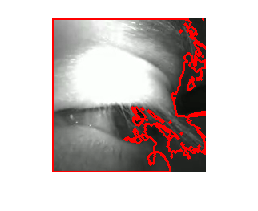
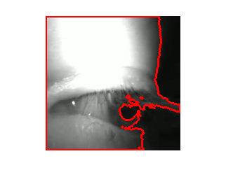
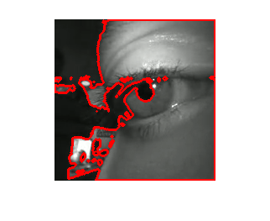
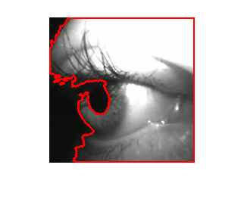
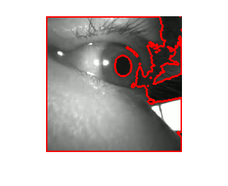
P1
P2
P3
P4
CONTROL
OKN-G
OKN-MMIC
5 deg
2 sec
OKN-C
Notes:
FIGURE 7. Examples of results from four participants that formed the retest group. The participants (P1-P4) are shown column-wise. The first row shows results for OKN-G. The second row contains data for OKN-MMIC, and the third row only contains data for the control participant, who was had less than 30%data loss. The final row shows the segmentation results to indicate the reason for failure which were: P1=eyelashes, P2=distortion of the pupil by eyelashes and shadowing linking to background pixels, P3-P4=shadowing over the pupil created by the iris created a link to background pixels. Also shown are yellow dots indicating the location where data was read from using MMIC. The control example shows good delineation of the pupil as indicated by the arrow.
NOTES FOR THIS IMAGE :

Slide 18
 | MCC | Sensitivity | Specificity | Accuracy
OKN-G | 0.76 | 0.85 | 0.95 | 0.88
OKN-C | 0.82 | 0.89 | 0.96 | 0.91
OKN-MMIC | 0.80 | 0.89 | 0.95 | 0.91
OKN-C-STEP | 0.83 | 0.93 | 0.92 | 0.92
OKN-MMIC-STEP | 0.85 | 0.95 | 0.90 | 0.93
Notes:
TABLE 1. Performance metrics for the “main” data-set across all methods tested.
NOTES FOR THIS IMAGE :

Slide 19
 | MCC | Sensitivity | Specificity | Accuracy
OKN-G | 0.67 | 0.73 | 0.97 | 0.81
OKN-MMIC | 0.85 | 0.88 | 1.00 | 0.94
OKN-MMIC-STEP | 0.87 | 0.91 | 0.97 | 0.95
Notes:
TABLE 2. Performance metrics for the “retest” data-set across all methods tested.

